Slide 1
OS Project Review-2 Scheduling algorithm
Ekansh Gupta-18BCI0175
Laksh Gupta-18BCI0190
Mihir Srivastava-18BCI0214

Slide 2
SCHEDULING OBJECTIVES
Objective of a Scheduling Algorithms are:
Maximize throughput: A scheduling algorithm ought to be equipped for adjusting the greatest number of jobs per unit of time.
Avoid inconclusive blocking or starvation: A job ought not sit tight for unbounded time before or while process service.
Minimize overhead: Overhead causes wastage of assets. Be that as it may, when we utilize system resources viably, then general system execution enhances extraordinarily.
Enforcement of priorities: if system allocates priorities to forms, the booking system ought to support the higher-need forms.
Attain balance between response, utilization: the scheduling algorithm must keep resources occupied .

Slide 3
SCHEDULING CRITERIA
CPU scheduling algorithms maybe such which have different properties, and the choice of one particular algorithm might favour one category of processes over other. Choosing an algorithm for a particular situation, we must cater to properties of various algorithms. The scheduling criteria include the following:
Context Switch: A context switch is process of storing and restoring context (state) of a preempted process, so that execution may be resumed from same point at a later stage. Context switching involves a lot of computation, lead to wastage of time and memory, which in turn increases the overhead of scheduler, hence operating system’s design, is to optimize only these switches.
Throughput: it is the number of processes completed per unit time. It is slow in round robin scheduling implementation. Context switching and throughput are inversely proportional.
CPU Utilization: Tells the business of the CPU. One needs to maximize CPU utilization.
Turnaround Time: Total time spent to complete the job. The time interval from the time of submission of a job to its completion is the turnaround time. Total turnaround time is the sum of the times spent waiting to get into memory, waiting time in the ready queue, execution time on the CPU and doing I/O.

Slide 4
Response Time: in real time systems, turnaround time may not be best measure. Often, a job can provide with some output fairly early and continue computing new results while previous results are being produced to the user. Thus, it is the time from the submission of a request until the first response is produced that means time when the task is submitted until the first response is received. Thus, the response time should be less.
Waiting Time: Time a job has been stalled in ready queue. The CPU scheduling algorithm does not affect the amount of time during which a process executes or does input-output; it affects only the amount of time that a process spends waiting in ready queue.
Hence a good scheduling algorithm for real time and time sharing system must have: -
less context switches.
high CPU utilization.
high throughput.
Less turnaround time.
Less waiting time.

Slide 5
Our Contribution:
We came up with a modified round robin/priority multilevel scheduling algorithm which works on a calculated time quantum that takes into account the priority and the burst time of the process. This will help in reducing the average waiting time, average turnaround time and reduce the number of context switch.

Slide 6
New innovative scheduling Algorithm
Algorithm:
Take the burst time and priority of the processes and calculate the new priority rank(75% priority and 25% burst time).
Arrange the processes according to the calculated rank.
Now we calculate the smart time quanta(STQ) by the formula:
mean+0.5*SD of all burst time
Now start executing the processes by round robin algorithm with STQ time quanta.
If a process is not finished in one go, we add the process to the other wait queue.
Now after all the processes are over in our executing queue, we execute all the processes in the waiting queue.

Slide 7
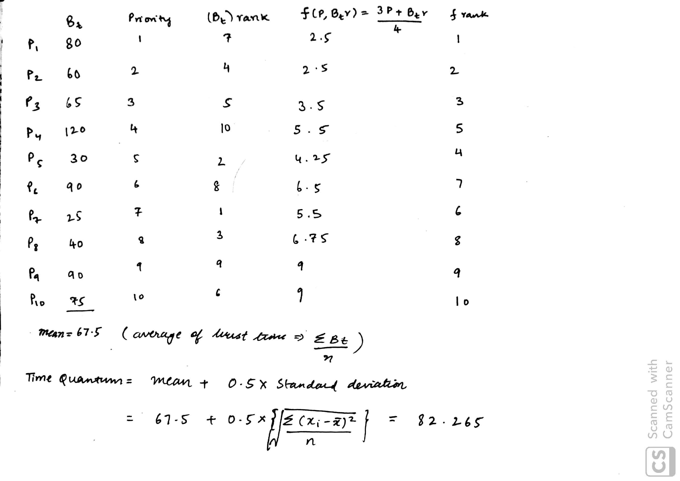
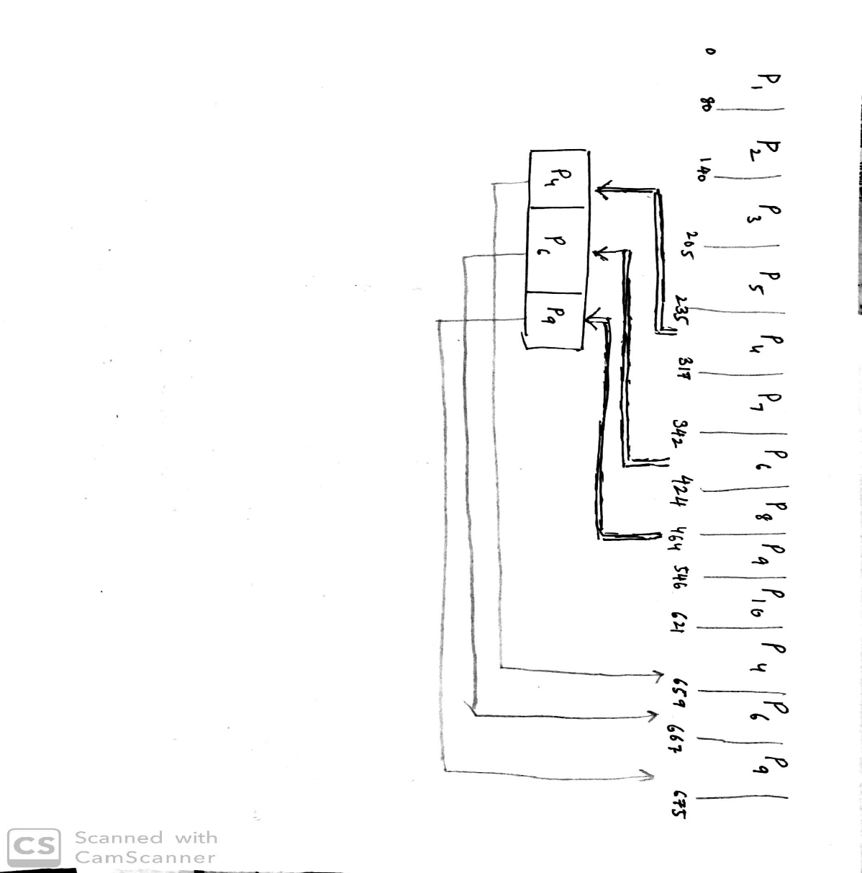
Sample process:

Slide 8
References
[1] Silberschatz, A., Peterson, J. L., and Galvin, B.,Operating System Concepts, Addison Wesley, 7th Edition, 2006.
[2] E.O. Oyetunji, A. E. Oluleye,” Performance Assessment of Some CPU Scheduling Algorithms”, Research Journal of Information Technology, 1(1): pp 22-26, 2009.
[5] William Stallings, Operating Systems Internal and Design Principles, 5th Edition , 2006.
[6] Saroj Hiranwal, K. C. Roy,” Adaptive Round Robin Scheduling using shortest burst approach based on smart time slice”, International Journal of Computer Science and Communication Vol. 2, No. 2, pp. 319-323, July-December 2011.

Slide 9
Thank you

